Slide 1
Time Series Forecasting in R using ARIMA
Submitted by: Mansi

Slide 2
Case Study- Sales Data
Objective: To build an Auto Regressive Integrated Moving Average (ARIMA) model to predict the sales data.
Business Problem: Using the monthly sales data (in thousand units) of an Automobile company, provided for the time period 2003-17 predict the sales for next 36 months.

Slide 3
About the data
The data set consist of 2 variables, date and sales. It comprises of monthly sales data from January 2003 to January 2017.
Observations:
An overall increasing trend can be observed in sales with an initial stagnant phase till 2007.

Slide 4
Methodology
We firstly transform our sales data into a time series in R where 1 represents the first month of every year and 12 represents the last month.
It’s the observed that datum has both a trend and drift, i.e. time invariant mean and variance. So to remove these we use differencing. The twice differenced datum continues to have unequal variance. To treat it, differencing along with log transformation of the datum is done.
We finally obtain a series that is stationary with Log10 and 2 order of differencing.
This stationary time series is now used to run the ARIMA function. With the model, we obtain the predicted values for the next 3 years.

Slide 5
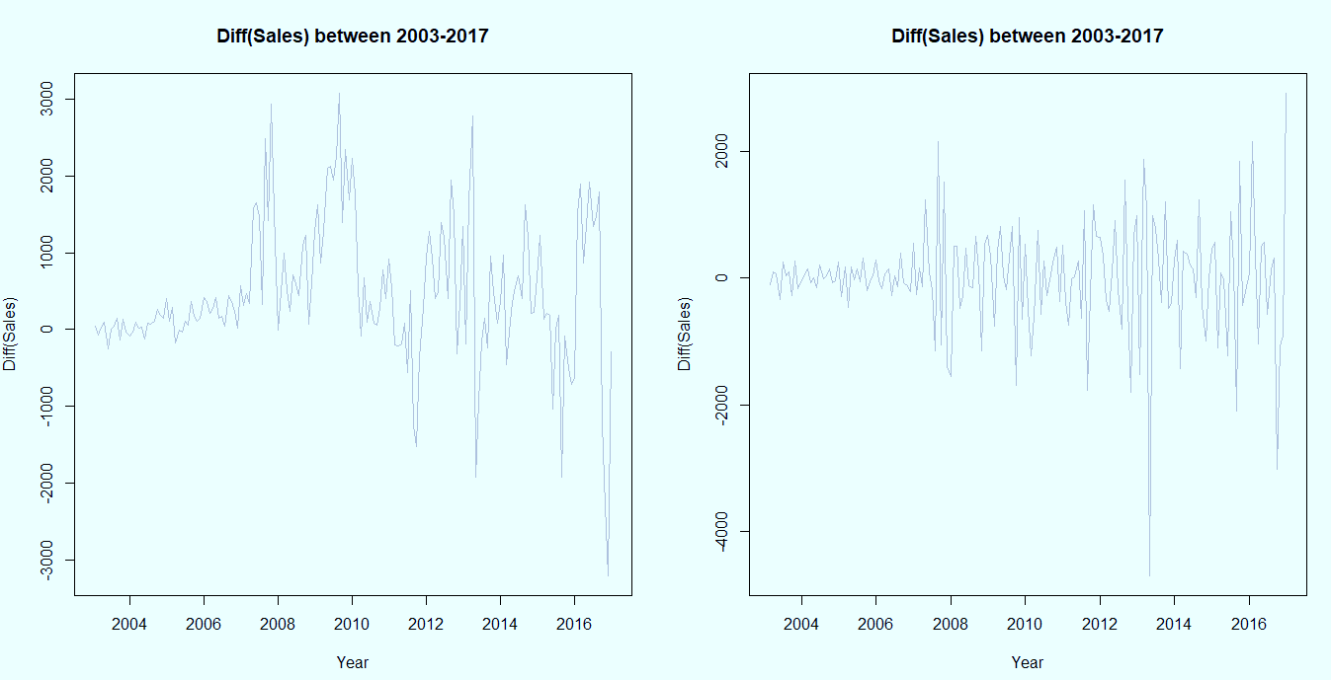
Statistical Interpretation
D=1
D=2
Stationarity is the basic assumption of an ARIMA model. To obtain stationarity we use differencing method. These plots show the diff(Sales) vs the years. It can be clearly seen that optimum stationarity is observed when d=2.

Slide 6
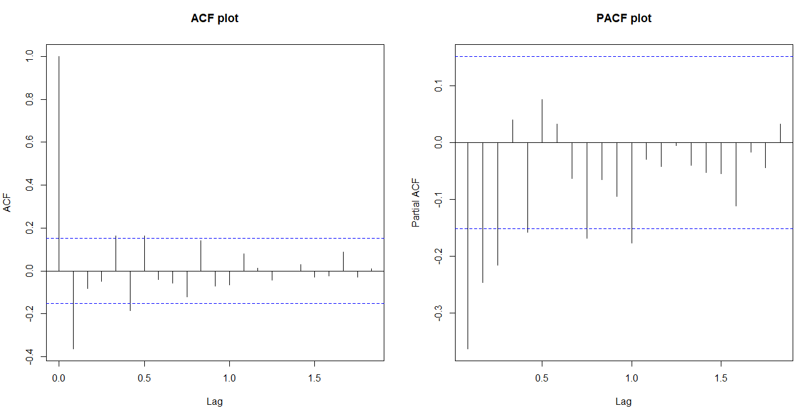
ACF and PACF plots
On the stationary time series, we plot ACF and PACF and observe them to obtain the value of ARIMA function parameters i.e. values of Moving Average (or q) and Auto Regressive (or p) respectively. Using the values of p,d and q, we run ARIMA function. Here p and q are both 0.

Slide 7
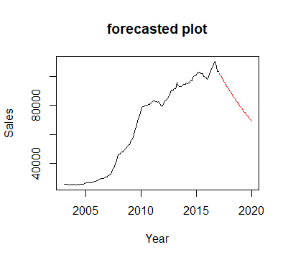
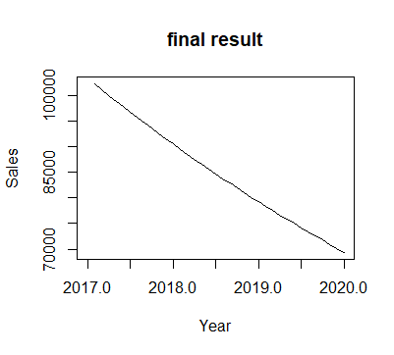
Results
According to our model, the sales are forecasted to be steeply dipping for the next 36 months. This happened because our model related upcoming sales to one month prior sales. Since, 2017 Jan witnessed a dip is sales, thus for the coming 36 months, it keeps following a dip.

Slide 8
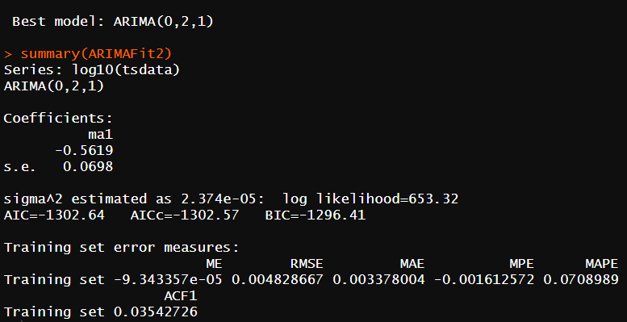
AUTO ARIMA
To speed things up, Auto ARIMA technique finds out the best fit model with the best combination for p,d,q automatically. Here we obtain (0,2,1) Also notice such a low value for MAPE.

Slide 9
Business Interpretation
(p,d,q) (0,2,1)
Auto regressive term (AR)=0 for lags of previous sales values
Integral (I)=2 for non stationary differencing
Moving Average (MA)=1 for error terms
MAPE for this model is very low implying the low deviance of the predicted model from the actual values.

Slide 10
Recommendations
According to the model, the sales are tending towards a downfall, so the business should beforehand come up with various revised and new schemes and offers to attract customers as much as possible.
For this, the business should focus more on marketing strategies and also the quality of its products and services for maximum consumer satisfaction.

